Slide 1
Sentimenatal Analysis On Restaurant_Reviews
Using Machine Learning

Slide 2

1.Student Details:
1.Name: R.REDDY RANI
2.SkillsBuild Email ID: reddyraniragala@gmail.com
3.College Name: Rajiv Gandhi University Of Knowledge Technologies , RK Valley(KADAPA)
4.College State: Andhra Pradesh
5.Internship Domain: Artifical Intelligence
6.Internship Start date: 18th August,2023
7. Internship End date: 30th September,2023

Slide 3
2.PROJECT TOPIC
Create a machine learning model where restaurant owners can input customer reviews and get accuracy of the each model .
The dashboard could provide insights into customer satisfaction,
identify areas for improvement and track performance over time.

Slide 4
3.AGENDA
The objective of this project is to develop a sentiment analysis model that can automatically classify restaurant reviews into positive, negative sentiments. This will provide valuable insights to restaurant owners for improving customer satisfaction and making data-driven decisions.
Here the Machine learning will provide different approaches to get the best accurate model for the data given.

Slide 5
4.PROJECT OVERVIEW
The project’s goal is to use machine learning to create a sentimental analysis model for restaurant reviews . The objective is to classify reviews into positive , negative reviews giving restaurant owners useful information.
Data collection and preprocessing, exploratory data analysis, feature extraction, model choice and training, and hyperparameter tuning are important elements.
The project has the possibility for future extensions or interaction with existing systems and seeks to increase customer satisfaction through targeted improvements based on feedback analysis .
If it is implemented effectively , restaurant owners will have a useful tool for interpreting and responding to client opinion.

Slide 6
5.WHO ARE THE END USERS?
Sentimental analysis is a valuable tool for various stakeholders in the restaurant industry , including restaurant industry, including restaurant owner, marketing teams, customer service representatives, quality assurance teams, business analysts, market researchers, investors, food critics, app developers, and data scientists.
It provides insights into customer feedback, enables targeted marketing strategies, and helps maintain food quality standards . The analysis can also be used by business analysts to generate reports and provide strategic recommendations , while market researches can understand consumer behaviour and preferences.
This project can positively impact various aspects of the restaurant industry, including customer satisfaction, operational efficiency and marketing strategies.

Slide 7
6.YOUR SOLUTION AND ITS VALUE PROPOSITION
The sentimental analysis solution offers restaurant owners a data driven approach to understand customer feedback, enabling them to identify areas for improvement and capitalize on strengths . It also aids in efficient resource allocation by identifying frequently mentioned aspects in reviews such as food quality, service and ambiance.
The tool provides real-time monitoring and trend analysis, enabling immediate response to negative feedback and tracking sentiment changes over time.
The solution can be adapted to meet the growth of a restaurant business and integrates seamlessly into existing systems . It results in cost savings and increased revenue , providing a positive return on investment.

Slide 8
7.HOW I CUSTOMISED THIS PROJECT?
In the existing model , they have used the multinomial naïve bayes to train and test the model with old featuring of data to be processed by the CountVectorizer.
But in this model by making use of those additionally I added the Corpous and PortStemmer for the Classification of data into clean manner.
This makes my model unique to the existing one.
And added to the above I plotted the “Heat Map” of the model to give the True and False Values.

Slide 9
8.MODELLING
Steps used in the process:
Data Acquisition and Preprocessing
Exploratory Data Analysis
Feature Extraction
Model Selection and Training
Hyperparameter Tuning
Deployment and Integration

Slide 10
I have used five machine learning algorithms to test the accuracy of the data.
1.Support Vector Machine:
A Support Vector Machine (SVM) is a powerful machine learning algorithm used for both classification and regression tasks. It works by finding the optimal hyperplane that maximizes the margin between different classes in the feature space, making it particularly effective in high-dimensional spaces and for datasets with complex decision boundaries.

Slide 11
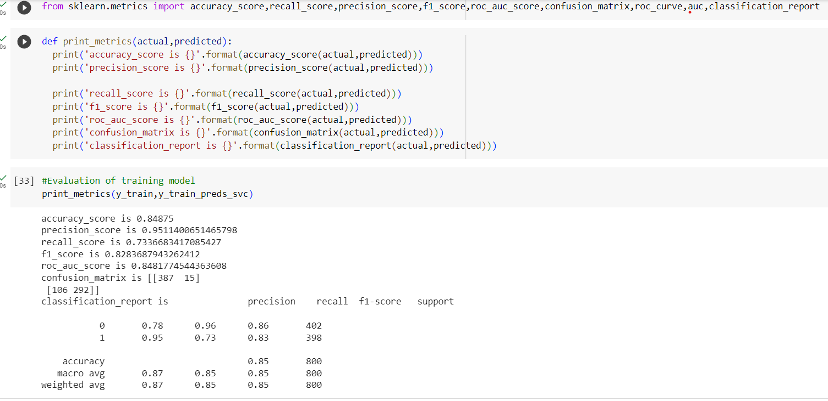

Slide 12
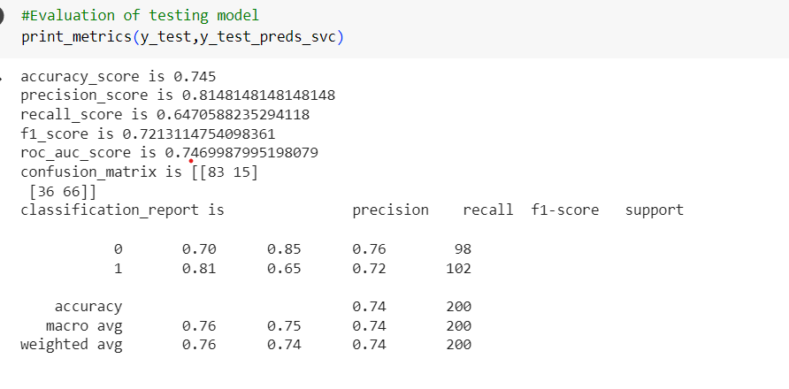

Slide 13
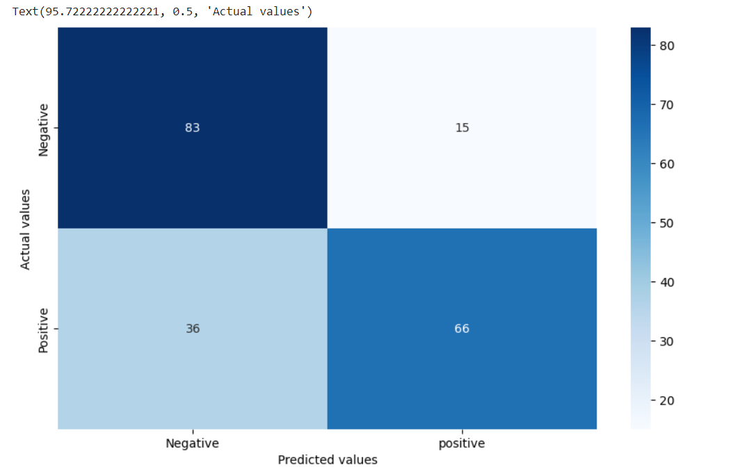

Slide 14
2.Logistic Regression:
Logistic Regression is a statistical model used for binary classification tasks. Despite its name, it's used for classification, not regression. It estimates the probability of a binary outcome based on input features, and applies a logistic function to map the output between 0 and 1, making it suitable for problems like spam detection or medical diagnosis.
I have provided the result in the figure by plotting using the matplotlib

Slide 15
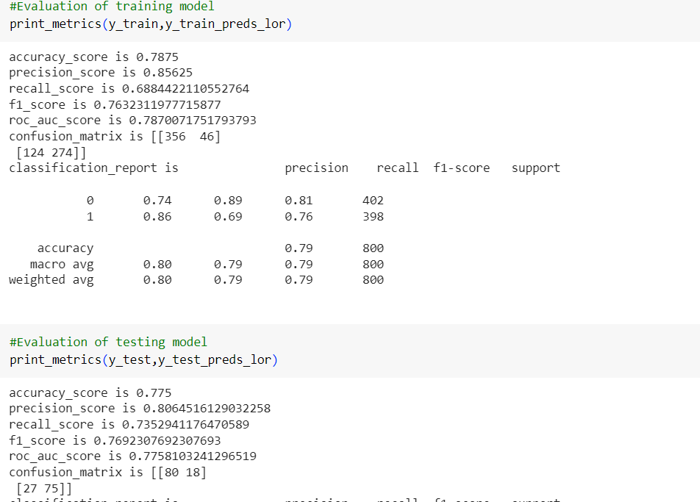

Slide 16
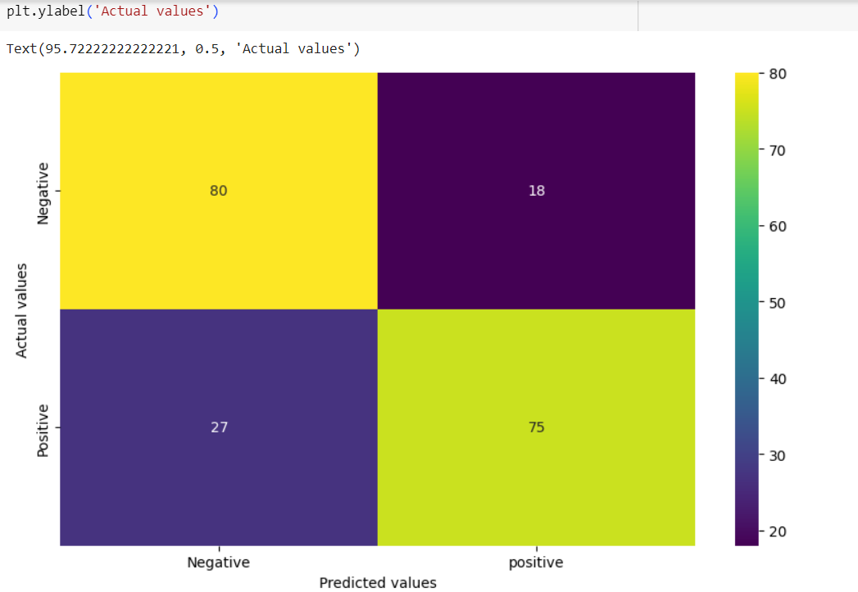

Slide 17
3.Random Forest Classifier:
The Random Forest Classifier is an ensemble learning method that builds multiple decision trees during training and combines their predictions to improve accuracy and reduce overfitting. Each tree is constructed using a subset of the training data and a random selection of features, resulting in a robust and versatile model that excels in both classification and regression tasks.

Slide 18
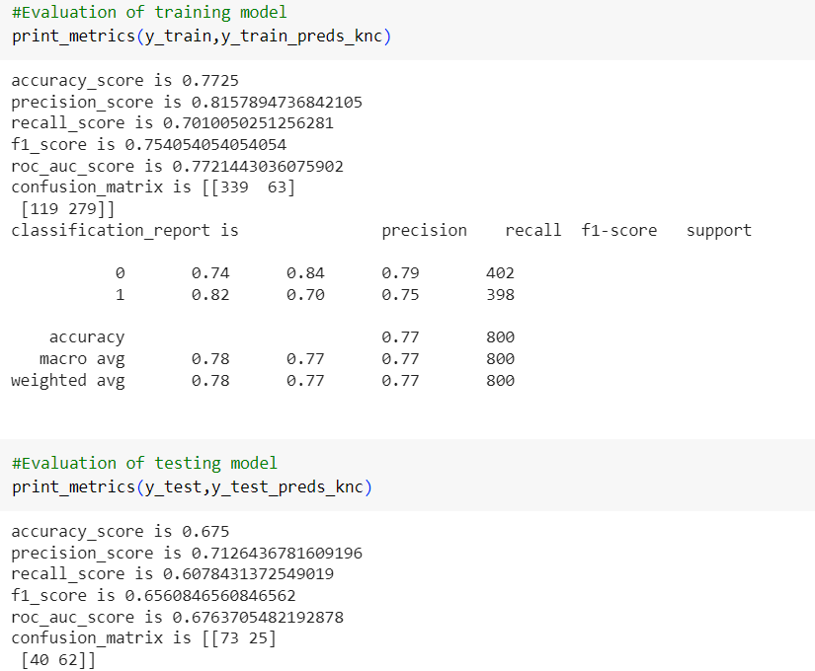

Slide 19
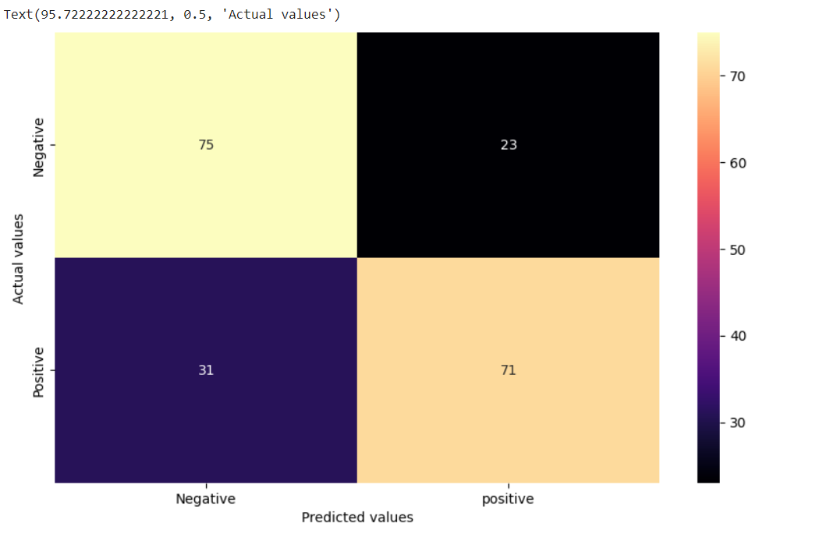

Slide 20
4.Gradient Boosting Classifier:
The Gradient Boosting Classifier is an ensemble learning technique that builds an additive model by training weak learners sequentially, each one correcting the errors of its predecessor. It combines the predictive power of multiple models, resulting in a highly accurate and robust classifier widely used in both classification and regression tasks

Slide 21
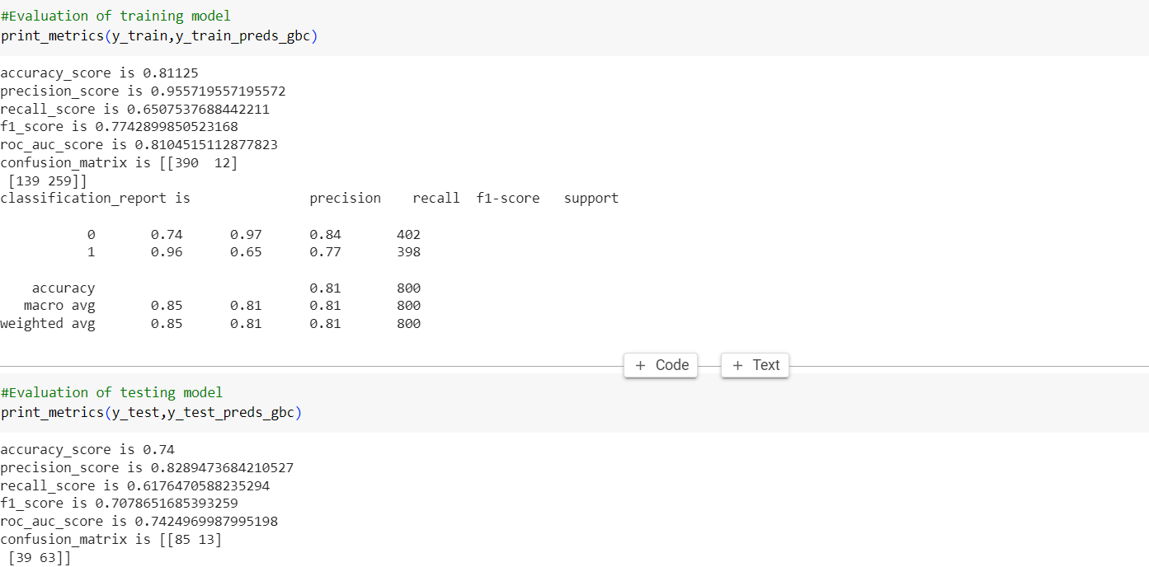

Slide 22
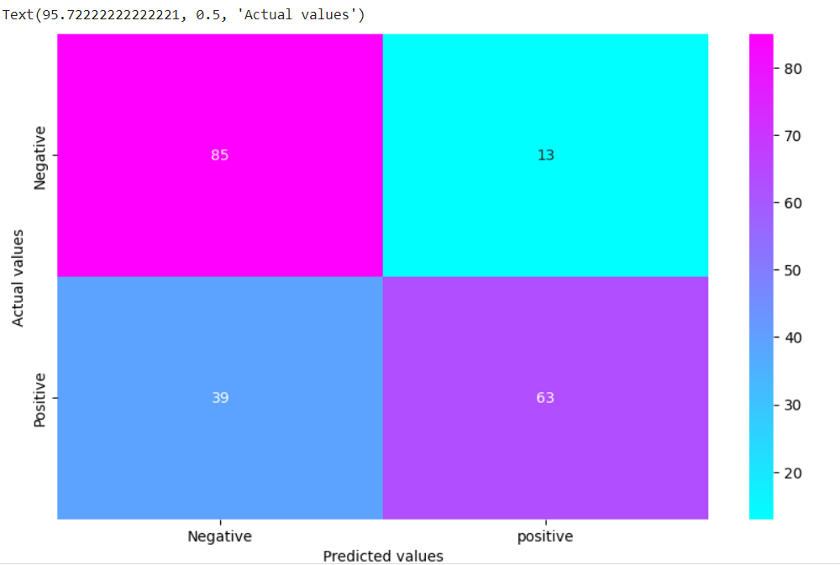

Slide 23
5.K-nearest Neighbour:
The k-Nearest Neighbors (k-NN) classifier is a simple yet effective machine learning algorithm for both classification and regression tasks. It makes predictions by identifying the k-nearest data points in the training set to a given test point and assigns the most common class label (for classification) or calculates the mean (for regression) among its neighbors.

Slide 25
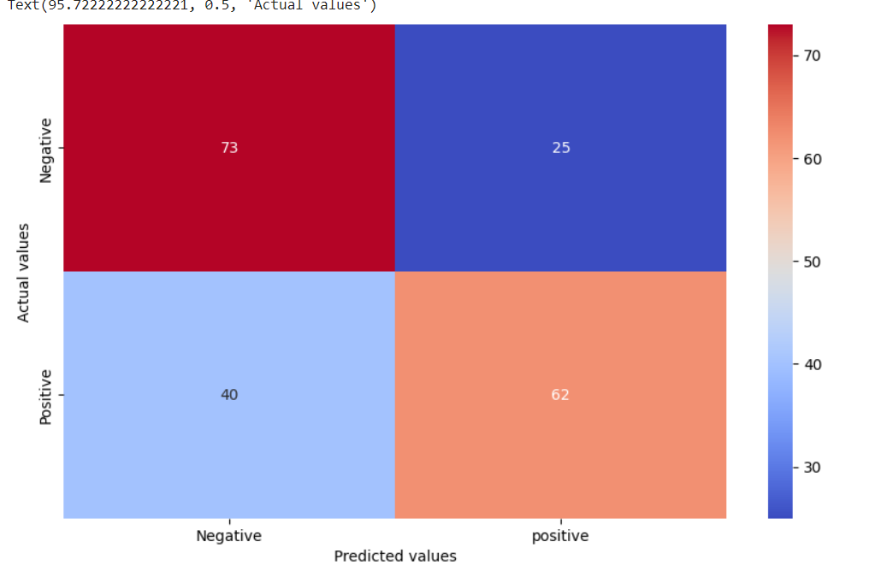

Slide 26
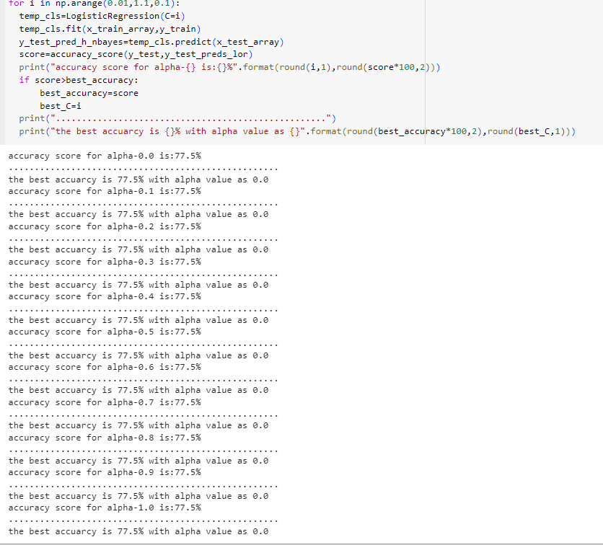
9.RESULTS
I have concluded by getting the accuracy of all five algorithms that “Logistic Regression” gives best accuracy among all the classifiers tested.

Slide 27
10.Links
Here I am Providing the GitHub link for my code:
https://github.com/Reddyrani28/Sentimental_Analysis_Restuarant_review.git

Slide 28


